Slide 1

HOUSE PRICE PREDICTION
USING MACHINE LEARNING

Slide 2

HOUSE PRICE PREDICTION
USING MACHINE LEARNING
PROJECT MEMBER
Khalid Ahamed Rahi
ID 2104010202202
Shafayet Ullah Ramim
ID 2104010202219
Shihabul Alam Shakib
ID 2104010202221

Slide 3
INTRODUCTION
Predicting house prices is essential for buyers and investors to make informed decisions by understanding market trends and financial planning. The analysis aims to uncover the relationship between various house features and their impact on prices, helping buyers avoid potential risks and make confident property decisions. This insight can also assist in identifying the most valuable property attributes for future investments.

Slide 4

MOTIVATION
Market Needs: The dynamic nature of the real estate market and the necessity for accurate price predictions.
Stakeholder Impact: How accurate predictions benefit buyers, sellers, investors, and policymakers in making informed decisions.
Risk Mitigation: Reducing the risk associated with real estate investments through data-driven insights.

Slide 5
Objective
Primary Goal: Develop a machine learning model to predict house prices using key features such as Avg. Area Income, House Age, Number of Rooms, etc.
Scope : Focus on data from the USA housing market and implement the model using Django.
Expected Outcome : A web-based application that allows users to predict house prices based on input data.

Slide 6


RELATED WORKS
Hedonic Pricing Models
Machine Learning Approaches
Gap Identified

Slide 7
METHODOLOGY
Data Collection
Data Preprocessing
Data Analysis

Slide 8
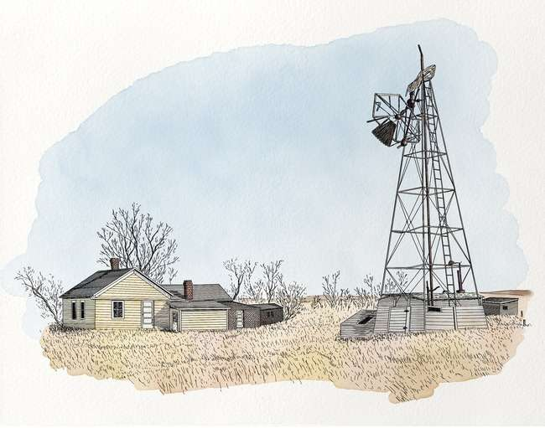
METHODOLOGY
Technology & Model:
Python
Django
HTML
CSS
Model
-Linear Regression

Slide 9

IMPLEMENTATION

Slide 10
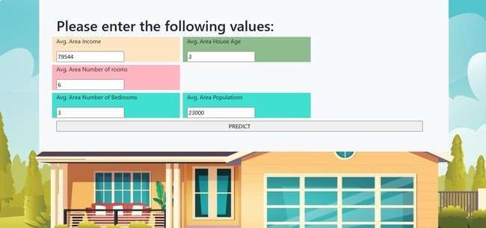
IMPLEMENTATION

Slide 11

FUTURE WORK
Model Enhancement: Explore more complex models like Random Forest or Gradient Boosting to improve prediction accuracy.
Feature Expansion: Include more features such as crime rates, proximity to schools, and transport facilities.
User Interface: Improve the UI/UX to make it more intuitive and user-friendly.
Deployment: Consider deploying the model as a REST API for broader accessibility.

Slide 12

CONCLUSION
Finally, linear regression was used to predict house prices, providing valuable insights into pricing new properties. Future work will explore time-series methods and incorporate more data to enhance prediction accuracy and reduce errors.

Slide 13


